Slide 1
Project Title: Youtube Data Analytics Project
Analyze Youtube Dataset to uncover key insights and trends
Team Name : Team Hackers
Team Members : Anuj, Saurav & Shruti
Role : Data Cleaning, EDA and visualization
Presented To : Analytics Circle
Date: 13 Oct 2025

Slide 2
Objective
Convert youtube data into meaningful insights –
Find out which content gain the highest view and engagement, Category performance across different countries, To study relationship between views, likes, and comments to measure content performance.

Slide 3
Dataset Overview
Source: Kaggle – “Youtube Trending Videos Dataset
Fromat: CSV file imported into python, SQl, power BI
Total Rows: 44,9791
Total columns: 31
Key columns
Video_id : Every video has a distinct _id
Video_category_Id : This tells which category the video beleongs to
Channel_title : This is a name of channel
Channel_country : This shows which country the channel beleongs to
Video_pub_date : This shows which date the video was published
Video_pub_day : This shows which day in a week the video was published
Video_pub_hour : This is a specific time(hour) of the day when a video is made publically available on youtube
Engagement_rate : This show how much people liked the content and how much they responded to it.
Like_ Ratio : This shows the percentage of viewers who are satisfied with or like your content

Slide 4
Role 1 : Data Cleaning
Firstly, I imported data into python using pandas library.
I converted video_published_at and channel_published_at column into seprate column date, day and hours.
I deleted video_description, video_tag, video_default_thumbnail, channel_localized_description, video_published_at and channel _published_at columns.
Standardize the country column by replacing ‘united states’ with ‘US’ . ‘India’ with ‘IND’ , ‘united kingdom’ with ‘UK’ and ‘united states emirates’ with “UAE”.

Slide 5
Filled missing values in view, like, comment, hour,dislike with “0” and description, category, day with “unknown” , Date with”1900-01-01”,Engagement rate and like ratio with mean().
“An ‘Engagement Rate’ column was created using the formula :
Engagement rate= (likes+ comment) / views.
This metrics helps measure how actively viewers interact with the videos.”
Dislike column was created using formula [‘video_view_count’*0.001]
Creted a like ration column using ‘like_ratio’=likes/(likes+dislikes)

Slide 6
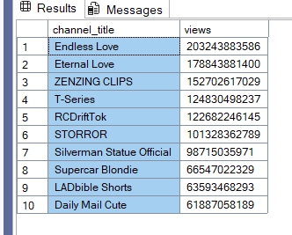
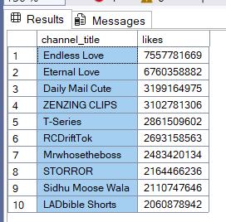
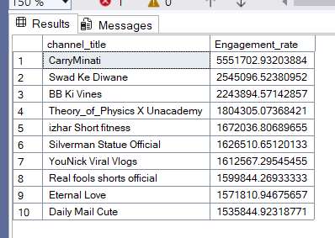
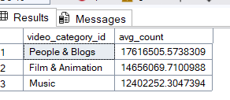
Role 2: Data Analysis & EDA
There are top 10 channels by total views, likes & engagement rate. In this table, the channel title (Endless love) has the most likes and views. Carry minati has the highest avg engagement_rate.
Peoples & Blogs category has the highest avg view count.

Slide 7

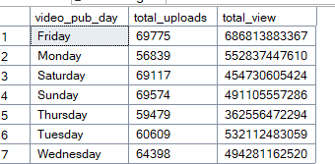
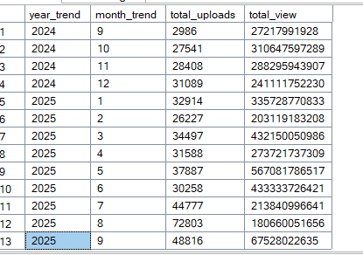
In this table I have compared country according to avg Engagement_rate. India has the highest avg Engagement rate compared to Uk and spain.
As you can see , The maximum no of videos are uploaded on Friday and the most views have also come on Friday.
According to the table, In may 2025 has the highest total views and the highest number of video uploads in Aug 2025.

Slide 8
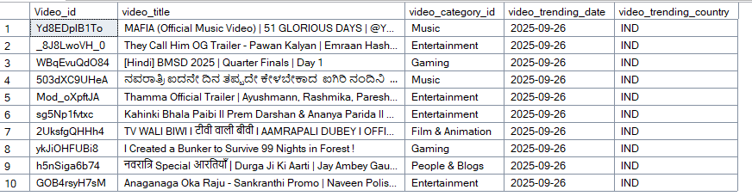
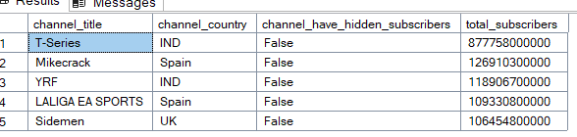
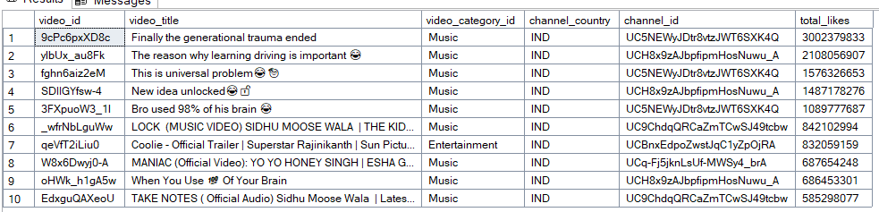
In this table, There are latest top 10 trending videos in india.
There are top 5 most subscribed channels, in this data you can see T- series has the highest subscriber 877 billion
There are top 10 most liked videos in India

Slide 9



Role 3: Visualization & Dashboard
The total video_view count is 3.6 trillion , It represent the total number of times a particular video has been watched by users.
The total video_like count is 95 billion , It represent the total number of likes received on a particular video.
The avg Engagement rate is 214 thousand, Engagement rate measure how actively viewers interact with a video through likes and comments, relative to the total number of views .

Slide 10
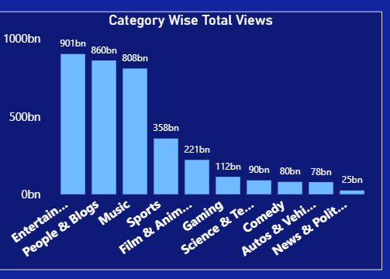
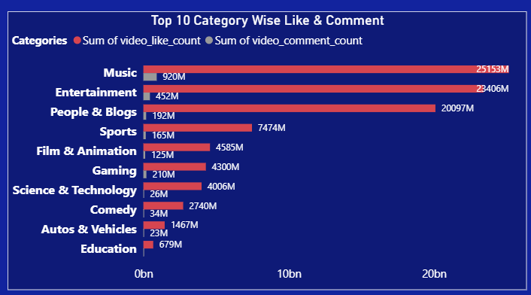
Performance by categories
This visualization shows the top 10 categories ranked by total views , helping to identify which category generate the most viewers engagement.
This chart presents the top 10 categories with maximum likes and comment , showcasing audience interaction and engagement trends.

Slide 11
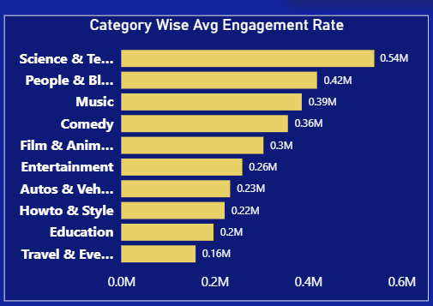
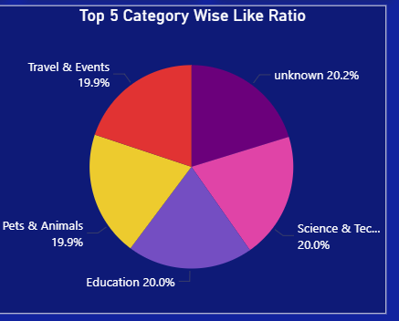
This visualization highlights top 10 categories achieving the best average engagement rate, helping identify the most engaging and responsive contents area.
This visualization highlights top 10 categories achieving the highest like ratio, reflecting audience appreciation and content quality perception.

Slide 12
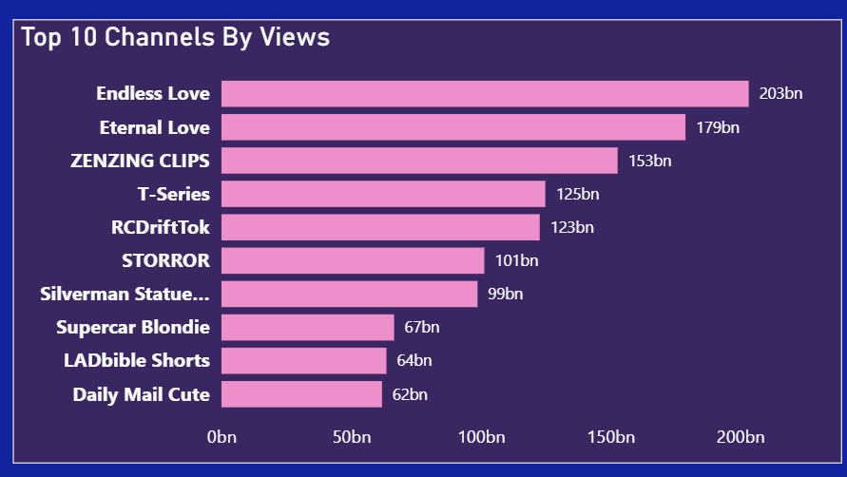
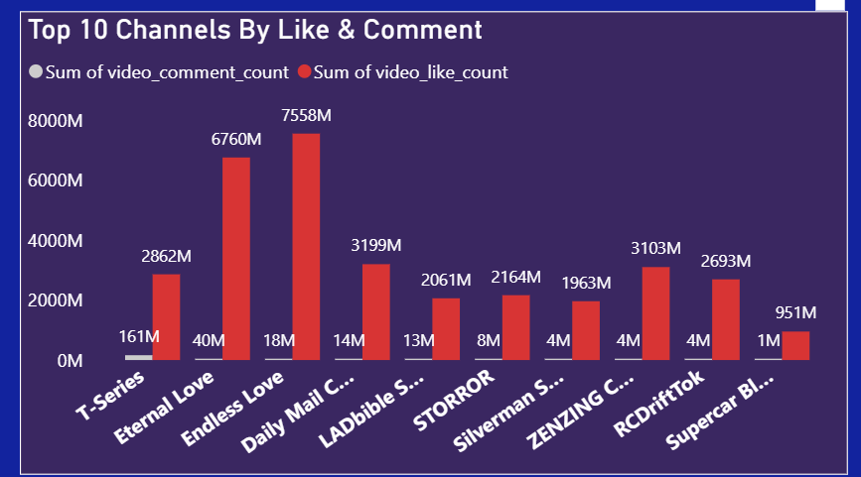
Top performing channels
This visualization shows the top 10 channels ranked by total views , helping to identify which channel generate the most viewers .
This chart presents the top 10 Channels with maximum likes and comment , helping to identify the most engaging channels for viewers.

Slide 13
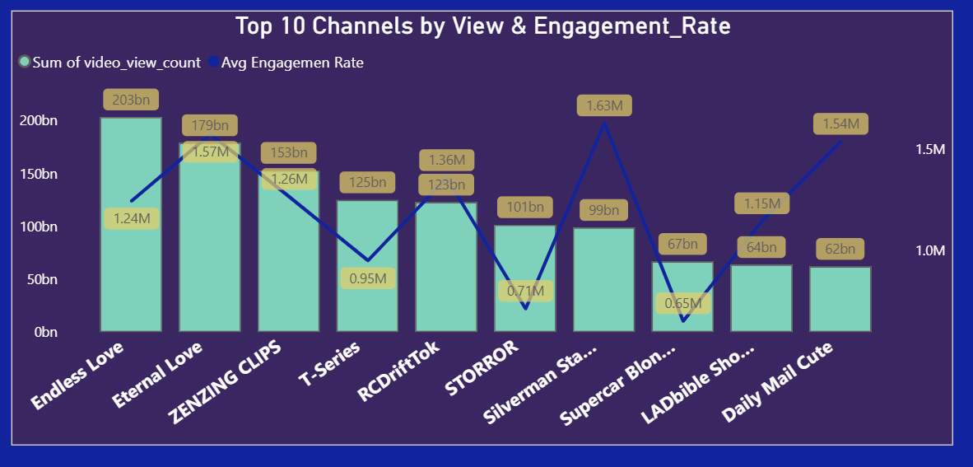
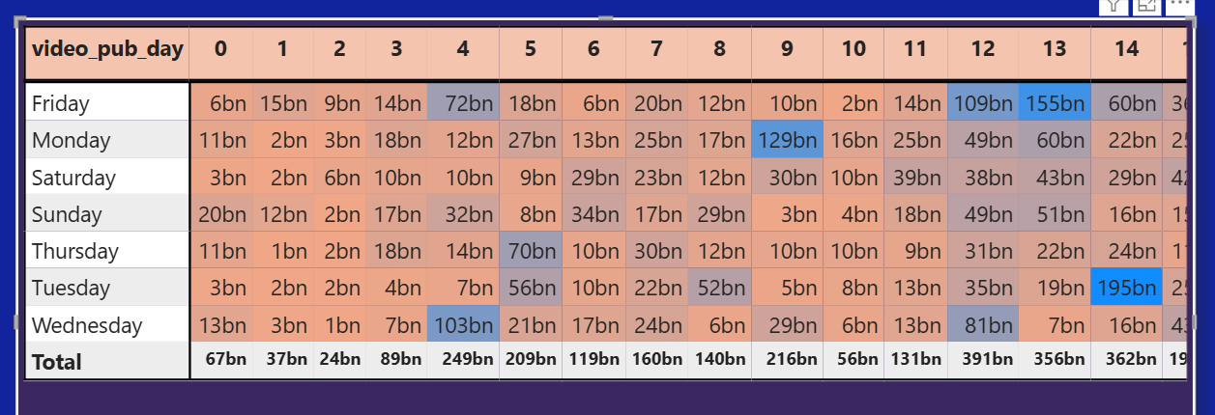
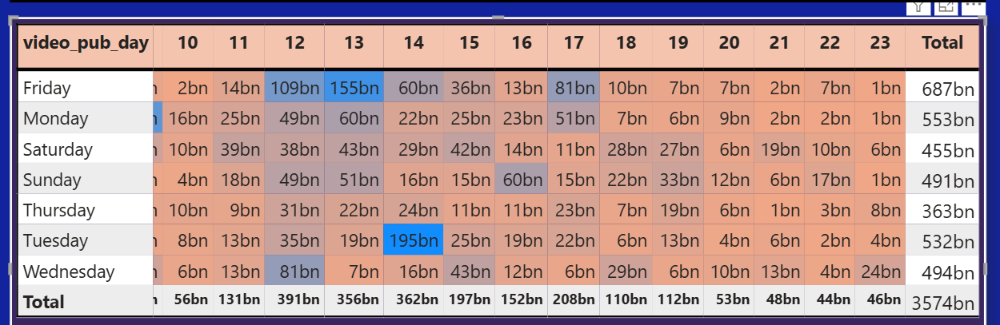
Heatmap Day- Hour vs Views
This visualization presents the top 10 channels ranked by total views and average engagement rate, helping to identify the most viewed and most engaging channels
This visualization highlights peak viewing times by mapping views across days and hours, allowing us to pionpoint when videos receive the highest engagement
Darker – Higher views
Lighter – Lower views

Slide 14
Recommendations
Post videos during the audience’s peak active hours to maximum views.
Focus more on high – performing categories to attract a large audience base.
Analyse audience comments and feedback regularly to refine content stratergy .
Maintain a consistent video upload schedule to improve audience retention and engagement.
Encourage viewers to like, comment and share to boost engagement rate.
Create more content similar to the videos that received the highest number of likes.

Slide 15
Conclusion
The youtube data analysis revealed how upload day, time and content type impact video performance .Videos uploaded on specific days gained higher views and interactions.
Consistent posting and audience focused content helped improve overall channel growth.
Like and Comment were found to be strong indicators of audience satisfaction and interaction.

